Slide 1
OOAD MINI PROJECT
TOPIC
RESTURANT MANAGEMENT SYSTEM
TEAM WOLVES
ADITI A SHUKLA
(RA1711003010353)
KUSHAGRA BHARDWAJ
(RA1711003010643)

Slide 2
INTRODUCTION AND OBJECTIVE
To represent how Restaurant business work like food odering and making reservations
The main objective is that to understand what is the real life scenario of the restaurant buiness in real life.
various scenarios are being explained with the help of
Use case
Class digram
Sequencial diagram
Collaboration diagram

Slide 3
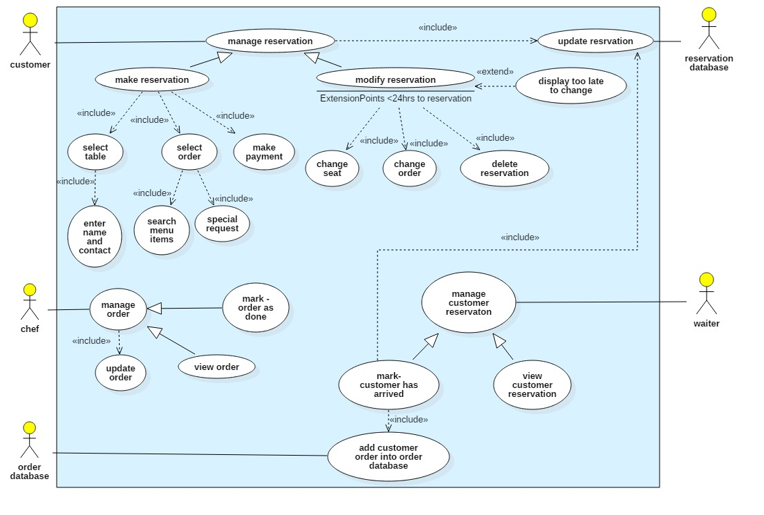
USE CASE DIAGRAM

Slide 4
EXPLAINATION
It shows external business view of a restaurant. We can see several business actors having some needs and goals as related to the restaurant and business use cases expressing expectations of the actors from the business.
like customer manages reservation which incudes update reservation and reservation database and is generalised into modify and make reservation which incudes various methods.
Chef manages the order which include updation of the order.

Slide 5
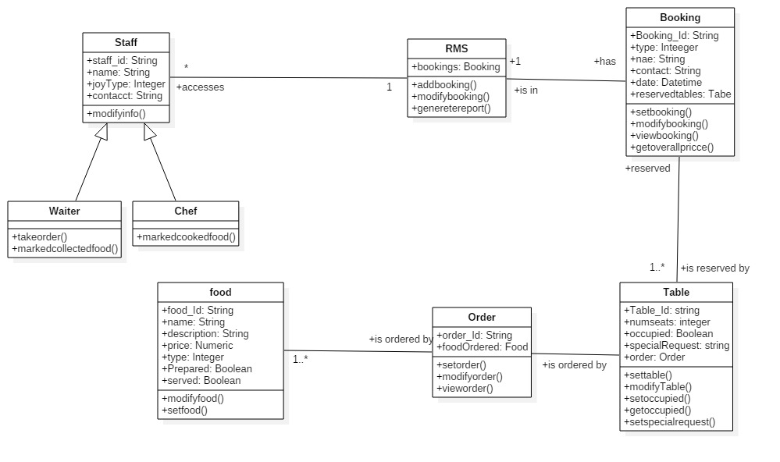
CLASS DIAGRAM

Slide 6
EXPLAINATION
This diagram represents staff working in restaurants.
The staff class is specialized into chef and waiter classes
the staff class is associated to RMS which has booking attributes and various operations like addbooking() and etc.
The RMS is associated to Booking class which has various attrbutes of the booking costumer dettails and thhe booking details.
Just like this the order class containing the order attributes is associated with food class.

Slide 7
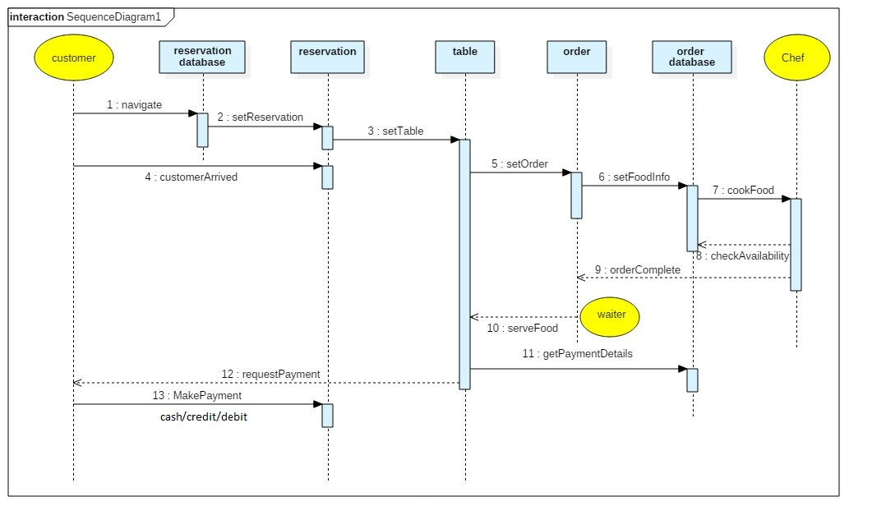
SEQUENCE DIGRAM

Slide 8
EXPLAINATION
It shows the flow of the message between various classes that are involved in the Restaurant business.
The flow of these messages occur one after the other .
There are life lines in the diagram such as customer database and many more.
The activation of these lifelines are represented by the long vertival rectangles which pass the messages.

Slide 9
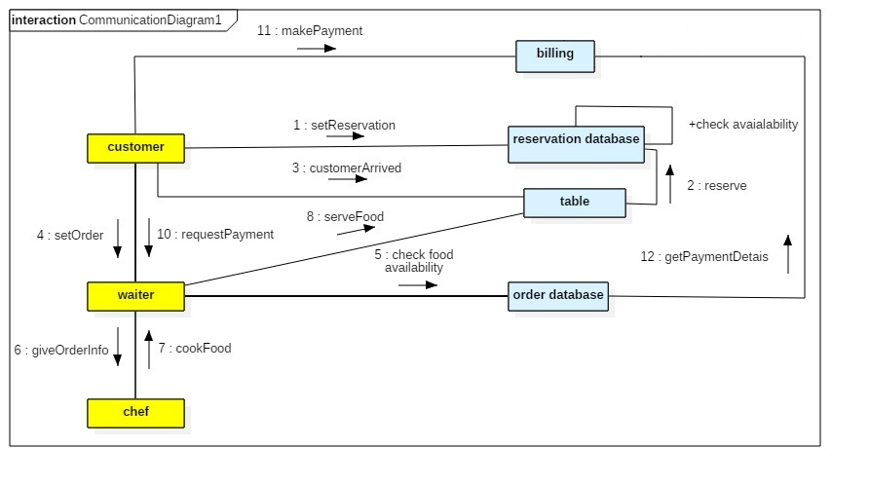
COLLABORATION DIAGRAM

Slide 10
EXPLAINATION
The method call sequence is indicated by a numbering technique. The number indicates how the methods are called one after another.
It is also a type of interaction diagrams which basically shows how the interaction occur between the classes.
Just like in this diagram the numbering is done to understand the flow of the message from one object to another.

